Slide 1
4 Connecting Smart Objects
Part I: Communication Criteria
Yuemin Ding
Tecnun School of Engineering
University of Navarra

Slide 2
Outlines
Communications criteria
Range
Frequency bands
Power consumption
Topology
Constrained devices
Constrained-node networks

Slide 3
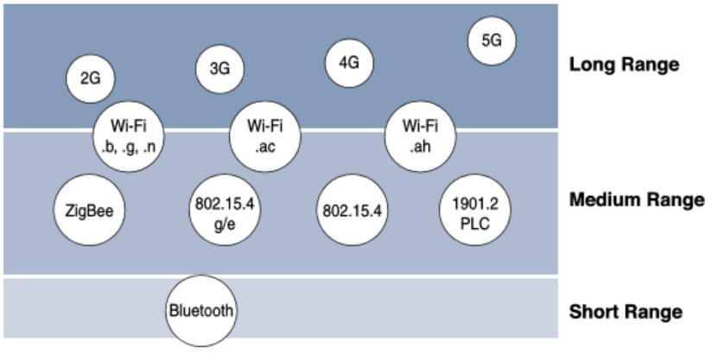
Communications Criteria - Range
Range - How far does the signal need to be propagated?
Short range, medium range, long range
R
NFC

Slide 4
Communications Criteria - Range
Range - How far does the signal need to be propagated?
Short range – tens of meters
Medium range – hundreds of meters
Long range – kilometers or longer
Range is not everything, topology matters as well.
NFC

Slide 5
Outlines
Communications criteria
Range
Frequency bands
Power consumption
Topology
Constrained devices
Constrained-node networks

Slide 6
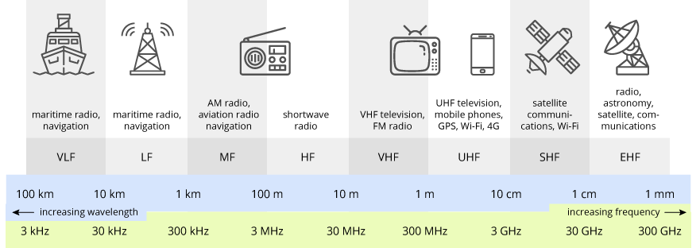
Communications Criteria
– Frequency Bands
Radio spectrum is regulated by countries and/or organizations, such as the International Telecommunication Union (ITU)
These groups define the regulations and transmission requirements for various frequency bands.
The spectrum for various communications uses is often viewed as a critical resource.
Source: terasense.com

Slide 7
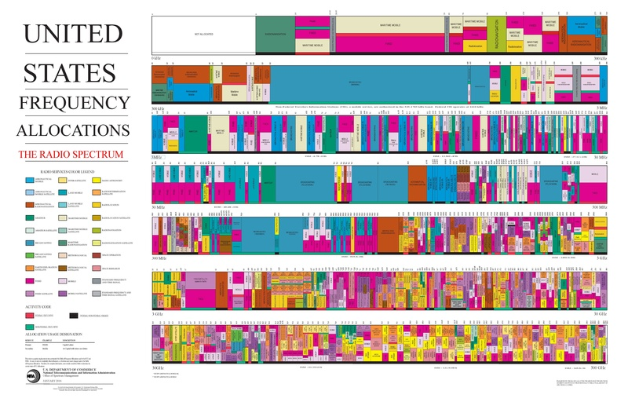
Communications Criteria
– Frequency Bands
Spectrum allocation in the U.S.
0 kHz
300 kHz
300 kHz
3 MHz
3 MHz
30 MHz
30 MHz
300 MHz
300 MHz
3 GHz
3 GHz
30 GHz
30 GHz
300 GHz

Slide 8
Communications Criteria
– Frequency Bands
For wireless communications, the frequency bands are split between licensed and unlicensed bands:
Licensed bands → require a license and payment (normally) before use, e.g. mobile communication, TV broadcast, aviation, etc.
Unlicensed bands → do not require a license and are free to use under regulations, e.g. Wifi, Bluetooth, etc.
Specific to IoT, both licensed bands and unlicensed bands are used up to the specific technology

Slide 9
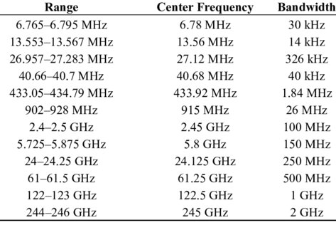
Communications Criteria
– Frequency Bands
ISM bands: unlicensed spectrum defined by ITU for industrial, scientific, and Medical applications
Source: Gyanendra, etc. Cognitive Radio Wireless Sensor Networks: Applications, Challenges and Research Trends, Sensors, 2013.

Slide 10
Communications Criteria
– Frequency Bands
The ISM bands are usually simpler to deploy but suffer from more interference
Mandatory regulations apply to guarantee compliance, such as transmit power, duty cycle, dwell time, channel bandwidth, etc.
IoT technologies on ISM bands:
IEEE 802.11b/g/n (Wifi)
IEEE 802.15.1 Bluetooth
IEEE 802.15.4 WPAN
IEEE 802.15.4g
IEEE 802.11ah
LoRaWAN
2.4 GHz
Sub-GHz, e.g. 868 MHz/915 MHz
Source: Gyanendra, etc. Cognitive Radio Wireless Sensor Networks: Applications, Challenges and Research Trends, Sensors, 2013.

Slide 11
Communications Criteria
– Frequency Bands
IoT on 2.4-GHz bands:
Short distances between two devices (several tens of meters to hundreds of meters)
Higher data rates (hundreds of kbps to Mbps)
IoT on Sub-GHz bands:
Allow greater distances between two devices (hundreds of meters to kilometers)
Lower data rates (tens of kbps to 1 Mbps)
Well-known bands: 169 MHz, 433 MHz, 787MHz (China), 868 MHz (Europe), 915 MHz (North America).

Slide 12
Communications Criteria
– Frequency Bands
IoT on licensed bands:
Adopt cellular technologies
Guarantee long distance and high data rates (from tens of kbps to hundreds of Mbps)
Require royalty fee (monthly or yearly)
Examples: 2G, 3G, 4G, 5G, NB-IoT, WiMax, etc.

Slide 13
Outlines
Communications criteria
Range
Frequency bands
Power consumption
Topology
Constrained devices
Constrained-node networks

Slide 14
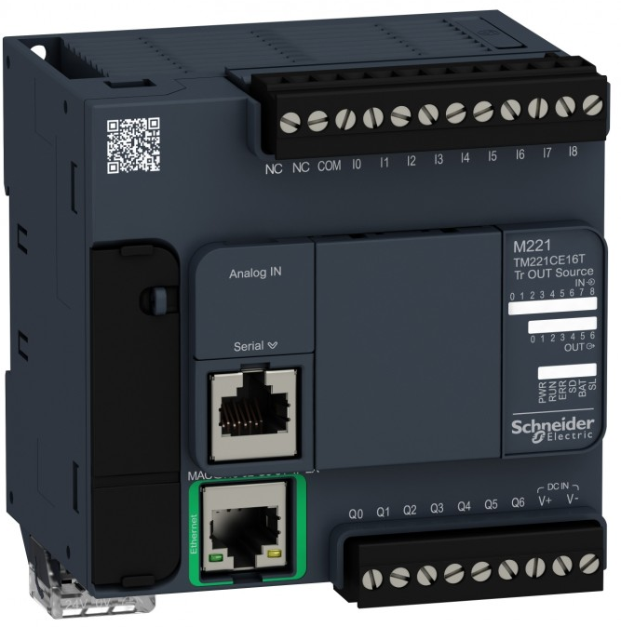
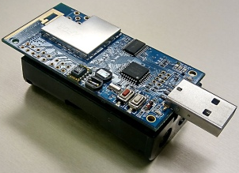
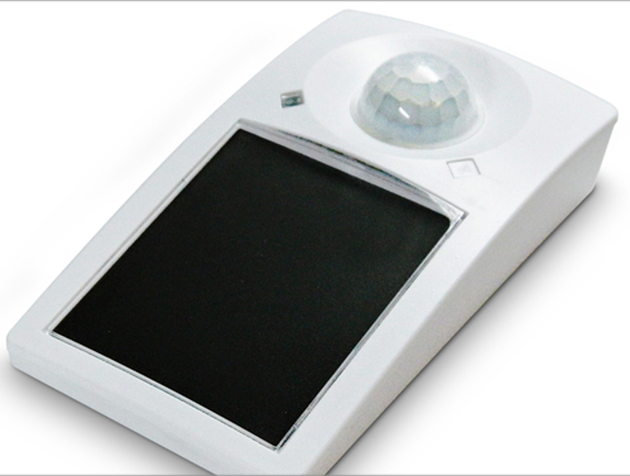
Communications Criteria
– Power Consumption
Powered IoT node:
Has a direct connection to a power source
Not limited by power consumption criteria
Limited by the availability of a power source
Battery-powered IoT nodes:
More flexibility with the deployment
Lifetime of the node matters, 2/5/10/15 years?
Low power access technologies must be used
Energy-harvesting IoT nodes:
Limitations on the deployment
The lifetime can be similar to power IoT nodes
Low power access technologies must be used (more critical than battery-power IoT nodes)

Slide 15
Outlines
Communications criteria
Range
Frequency bands
Power consumption
Topology
Constrained devices
Constrained-node networks

Slide 16
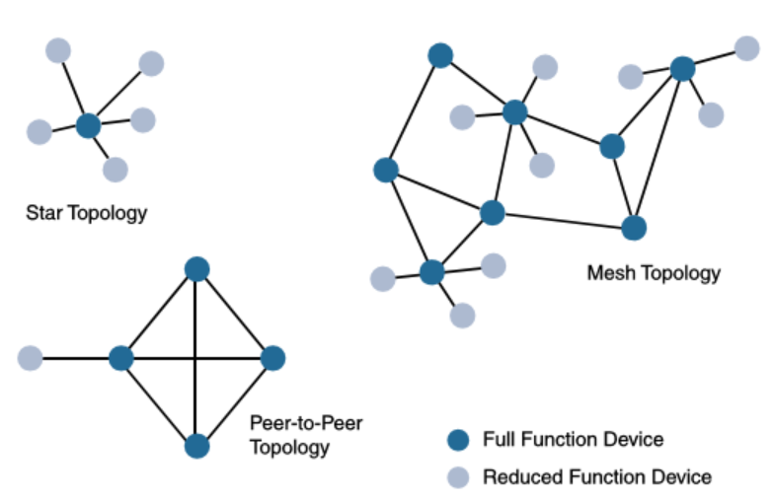
Communications Criteria – Topology
IoT topologies:
Star → a single central base station or controller to allow communications with endpoints
Clustered star/Mesh → Communication constrained by forwarding protocols
Peer-to-peer → Any device to communicate with any other devices in the range

Slide 17

Communications Criteria – Topology
IoT topologies:
Long/short range IoT technologies → Normally star topology, e.g. Bluetooth, NB-IoT, etc.
Medium range technologies → Star/mesh/peer-to-peer, e.g. WirelessHART.

Slide 18
Outlines
Communications criteria
Range
Frequency bands
Power consumption
Topology
Constrained devices
Constrained-node networks

Slide 19
Communications Criteria
– Constrained Devices
The Internet Engineering Task Force (IETF) defines different categories of constrained nodes.
Class 0: severely constrained.
Less than 10 KB of memory
Less than 100 KB of Flash processing and storage capability.
Typically, battery-powered.
Do not have the resources required to directly implement an IP stack and associated security mechanisms.
An example: a push button that sends 1 byte of information when changing its status.

Slide 20
Communications Criteria
– Constrained Devices
The Internet Engineering Task Force (IETF) defines different categories of constrained nodes.
Class 1: greater than Class 0.
10-50 KB of memory
100-250 KB of Flash processing and storage capability.
Sufficient resources for an optimized IP stack and security mechanisms.
Communicate with the network without the help of a gateway.
An example: environmental sensors reporting to a network server.

Slide 21
Communications Criteria
– Constrained Devices
The Internet Engineering Task Force (IETF) defines different categories of constrained nodes.
Class 2: greater than Class 1.
Greater than 50 KB of memory
Greater than 250 KB of Flash processing and storage capability.
Full implementations of IP stack security mechanisms.
An example: smart power meters supporting full IP communications.

Slide 22
Outlines
Communications criteria
Range
Frequency bands
Power consumption
Topology
Constrained devices
Constrained-node networks

Slide 23
Communications Criteria
– Constrained-Node Networks
Constrained-node networks are often referred to as Low-power and Lossy Networks (LLNs).
Low-power → power-constrained nodes, such as battery-powered or energy harvesting nodes
Lossy networks → interference and variability due to harsh radio environments.
Some IoT access technologies are more suitable for LLNs, such as IEEE 802.15.4, IEEE 802.15.4g, IEEE 1901.2a PLC, LPWA, and IEEE 802.11ah.

Slide 24
Communications Criteria
– Constrained-Node Networks
Data rate and throughput
Data rate → the transmission capacity of the physical channels, usually 100 bps to tens of Mbps for LLNs
Throughput→ actual successfully delivered data over the physical channels, usually measured with the unit of bps/kbps/Mbps
Throughput is less than the data rate

Slide 25
Communications Criteria
– Constrained-Node Networks
Data rate and throughput
It is very important to know the real throughput of an IoT technology and the required throughput of the application
An example:
IEEE 802.15.4g with 2FSK modulation at 915 MHz, the data rate is 150kbps.
If the forward error correction (FEC) is turned on, it drops to 75kbps.
If the protocol stack overhead is added, it only guarantees a throughput of 30-40 kbps

Slide 26
Communications Criteria
– Latency and Determinism
Latency, also called delay → the time it takes from the source node to the destination node.
Determinism → if the packet can be successfully delivered before the deadline.
Much like throughput, latency requirements of the application are very important to select an access technology
Particularly true for wireless networks as a result of the interference, collisions, noise, etc.

Slide 27
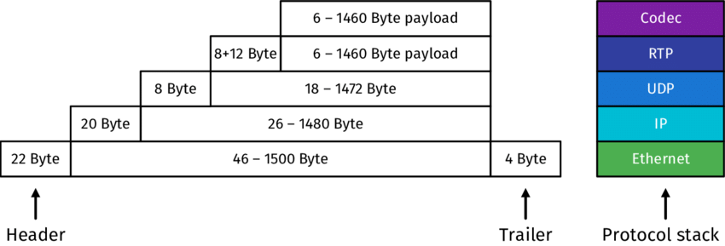
Communications Criteria
– Overhead and Payload
Overhead → extra bits used to control the communications
Payload → the delivered message contents

Slide 28
Communications Criteria
– Overhead and Payload
An example of IoT access technology
The payload size is 127 bytes for IEEE 802.15.4 and 2048 bytes for IEEE 802.15.4g
To support IPv6, the payload from the upper layer can be 1280 bytes.
IEEE 802.15.4 → fragmentation required
IEEE 802.15.4g → no fragmentation required

Slide 29
Summary
Communications criteria
Range
Frequency bands
Power consumption
Topology
Constrained devices
Constrained-node networks

Slide 30
Thank you!
Q&A

